Slide 1

6SENG010C · SOFTWARE ENGINEERING FINAL PROJECT · PROJECT PROPOSAL
Market-State-Conditioned Orchestration of Heterogeneous Agents for Financial Decision Support
How should the influence of methodologically unlike financial agents be set when the reliability of their evidence channels varies with market conditions? I design, implement and evaluate a market-state-conditioned orchestration operator on Colombo Stock Exchange data.
STUDENT
IIT / UOW ID
SUPERVISOR
ACADEMIC YEAR
Shaahid Fathul
20223216 · W1986734
Guhanathan Poravi
2026 to 2027
Notes:
Open on the question, not the technology. One line: four agents produce signals, something has to turn them into one decision, and in the systems I reviewed that combination is fixed at design time. The project is about the combination step, not about building a profitable trading application. Say the word "orchestration operator" once and move on.

Slide 2
PROPOSAL STORYLINE
Two spines The left column is the academic inquiry; the right is the software engineering artefact.
Examiner focus Examiners will see concrete software engineering evidence backing each research assertion.
A research spine and a software engineering spine, carried together
Table 1.1 · Dual-Spine Matrix
Research spine | Software engineering spine | Where it is
Agent reliability varies with market state; reviewed systems combine as though it does not | A pipeline that does not emit confident output from an empty channel | Slides 3, 9
59 reviewed papers, the six nearest systems contrasted clause by clause | Every requirement carries the paper or the measurement that forced it | Slides 4, 5, 6, 8, 10
One main question, two supporting, each answerable by a planned experiment | Four agents, one orchestrator, nine stated exclusions | Slides 6, 7, 10
Design science, controlled comparison, five arms, one ablation per state input | Five layers, point-in-time access, a verified data pipeline | Slides 11 to 15
An operator with a named lineage, plus evidence on whether it earns its place | Research prototype, no interface, three decisions changed by responsible practice | Slides 16 to 20
Spoken: I will show the gap and the contribution, then how the artefact, methodology and evaluation address it, then what I am not claiming. Slide 2
Notes:
This is the map, not a section to dwell on. Fifteen seconds: the left column is the inquiry, the right column is the build, and they are the same project seen twice. Point at the right-hand column and say that the examiners will see software engineering evidence for every research claim.

Slide 3
PROBLEM AND GOAL · CRITERION 1, 10 PER CENT
Core premise
Influence over a shared decision is fixed at design time
Four agents produce signals, but static combinations fail when individual channel reliability fluctuates.
Four agents produce signals, and something must turn them into one decision. In the systems I reviewed that combination is set once and never moves, and in most of them there is no weight object at all to move.
SIGNIFICANCE
STAKEHOLDERS
GOAL
OUTCOMES
Evidence of significance
Who is affected
Project goal
Expected outcomes
The investment decision-maker acting on the output, the researcher running the comparison, and retail participants least able to absorb a cost a model assumed away.
Build the operator and produce attributable evidence on whether conditioning earns its place against fixed, static learned and performance-reactive weighting. Not on whether the system is profitable.
Target
Three documented failures: a CSE study fixing a 3:1 split on an easier task’s score; an optimiser fed uncalibrated model-authored returns; a pool degrading 10.36 points through a fixed prompt.
A pipeline where changing liquidity changes the weights, a five-arm comparison with ablation deltas, a CSE baseline set, and a stated position on confidence comparability.
Attributable orchestration evidence, not portfolio profitability.
Researching an orchestration mechanism, not building a profitable trading application.
Slide 3
Notes:
Lead with the sentence in the large type and pause. The three failures are the evidence that this is a real problem and not a tidy one I invented; name one of them, the 3:1 split, because it is on this market. Be explicit that profitability is not the acceptance test, because that is the first thing a panel assumes about a trading project.

Slide 4
FROM EVIDENCE TO RESEARCH GAP · CRITERION 2, 10 PER CENT
Four lines of evidence, one gap they converge on
Table 2.1 · Gap Convergence
Evidence source | What it shows | Limitation or tension | Resulting gap
Academic literature, 59 papers | Heterogeneity is widely adopted; combination is treated as a solved detail | Several systems carry no weight object. Those that do weight assets, not influence | Influence is fixed at design time and adapts to nothing measured outside the agent
Existing systems | Four named systems each get one necessary clause right | The nearest neighbour in each direction is strong, so the contrast must be clause by clause | I have not found a system that combines all four clauses at once
Domain evidence, the CSE | Volume Granger-causes the index at p = 0.0041; macro variables reach nothing | Channels go empty for days, so equal trust across agents is false here | A setting where channel reliability genuinely varies, and can be measured
Forecasting literature | Feature-conditioned combination learns weights over a heterogeneous pool | Its features are properties of the series, computed once from history | A generalisation along one identified axis, stated as such
Fifty years of evidence says equal weighting is hard to beat, which is why it is the pre-registered primary benchmark rather than a convenience baseline.
Convergence
The benchmark
Literature, systems, CSE data, and forecasting methods point to the same missing mechanism.
Equal weighting is the formal pre-registered primary benchmark.
Slide 4
Notes:
Read the last column down, not the table across. The claim in row two is bounded on purpose: I say I have not found such a system in the literature I covered, not that none exists. If asked how the four clauses were decided, they come from the clause-by-clause contrast in the gap matrix, which is backup slide B2.

Slide 5
CRITICAL LITERATURE LANDSCAPE · CRITERION 2, 10 PER CENT
Design impact
Three themes, and what each one forces on the design
Each thematic critique establishes an explicit architectural constraint.
THEME 1 · THE MARKET
THEME 2 · COMBINATION
THEME 3 · EVALUATION
Thin trading is the condition here, not an edge case
Every necessary clause exists somewhere, in a different system
A strong minority evaluates well, and almost none can be rerun
Volatility clustering in three CSE studies, long memory across all three regimes, and illiquidity shocks depressing returns.
Analyst pipelines, feature-conditioned combination, continuous state conditioning, and explicit weight vectors over assets.
Walk-forward, regime decomposition and cost sweeps appear. Of my 59 papers, 4 are reproducible from the paper alone.
Reproducibility
Only 4 of 59 literature papers offered standalone replication.
The gap is the conjunction, so the contribution is a generalisation
Cached outputs across arms, a pre-registered margin, a released pipeline
The conditioning variables are locally evidenced, not borrowed
Counts are of my own 59-paper corpus, not of the field. The classification rule that produced them is in the backup.
Slide 5
Notes:
The tinted strip at the foot of each card is the point of the slide: each theme ends in a design consequence rather than a summary. If pressed on the 4 of 59 figure, say it is my own coding over my own corpus, the rule is written down, and it is why reproducibility is designed in rather than claimed.

Slide 6
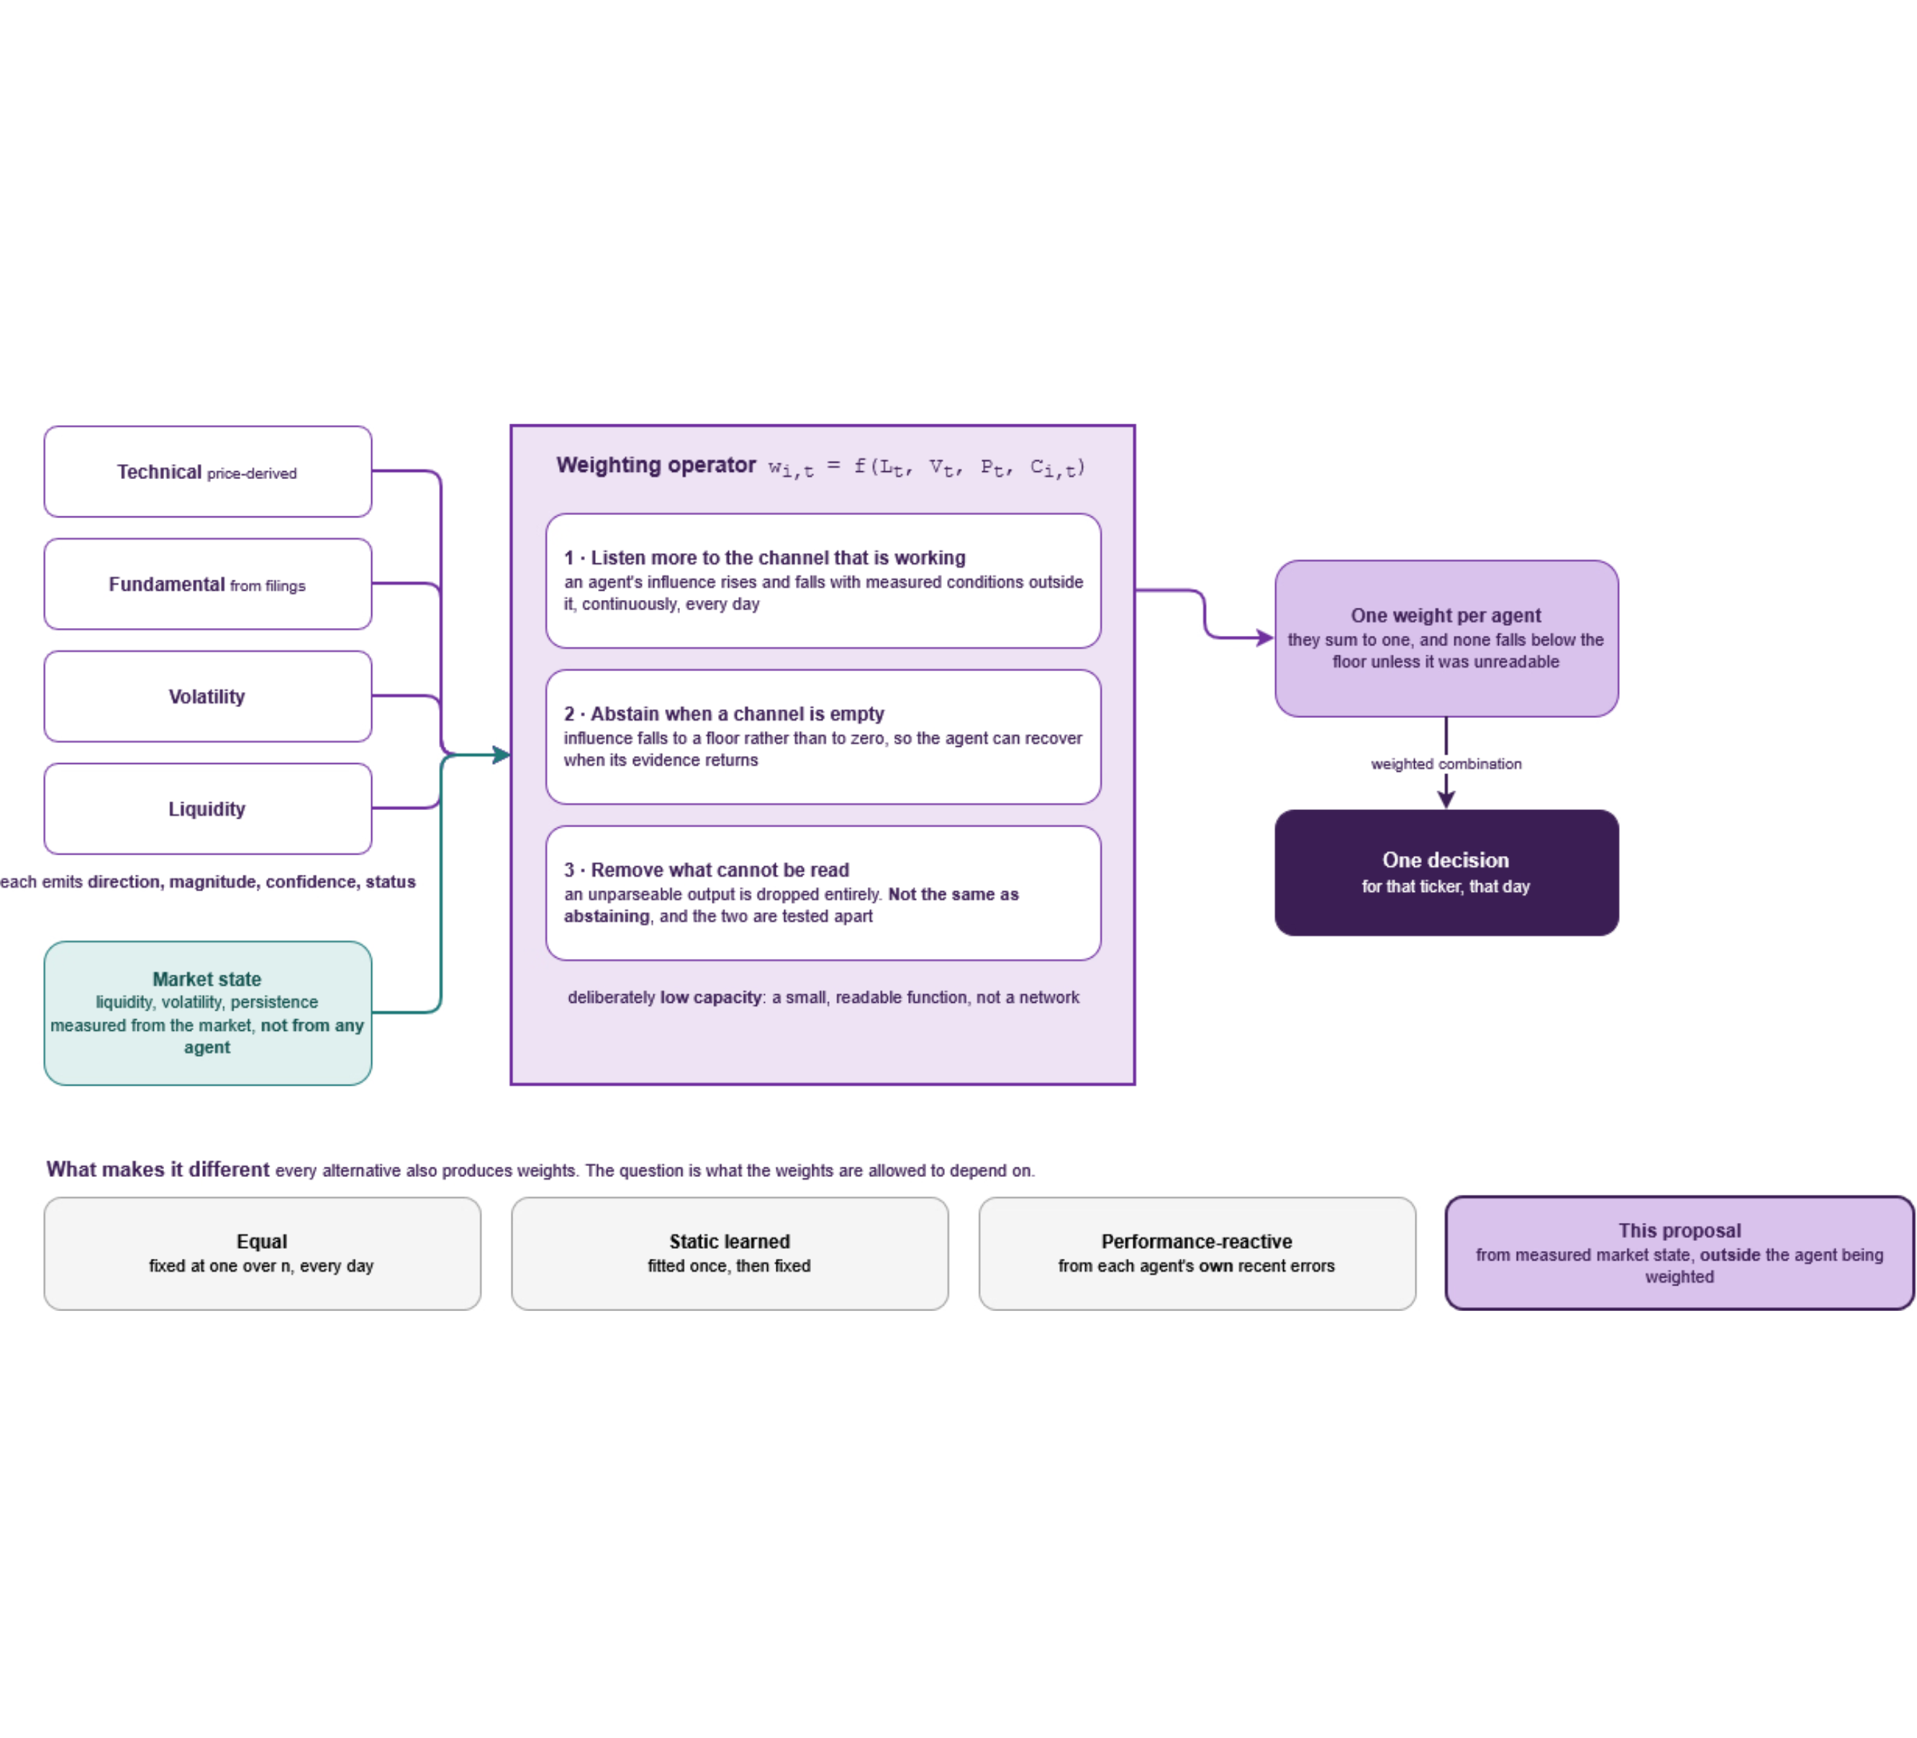

GAP, NOVELTY AND CONTRIBUTION · CRITERION 2 AND CRITERION 1
Fig. 2.1 · Decision Flow Architecture
Every alternative also produces weights. The question is what the weights may depend on
WHAT EXISTS
Multi-agent systems that combine analysts, mostly through a prompt. Influence fixed at design time.
WHAT IS MISSING
A weight that depends on conditions measured outside the agent being weighted, recomputed every step.
THE CONTRIBUTION
Attributable evidence on whether state-aware orchestration earns its place, positioned as a generalisation of feature-conditioned combination along one named axis.
Not a duplicated implementation. Three claims were withdrawn once I found papers that already did them, and the withdrawals are on the record.
The weighting operator and decision flow across four disparate agents.
Notes:
This is the slide to slow down on. Walk the diagram left to right once: four unlike agents, a state vector measured from the market and not from any agent, one weighting operator, one decision. Then point at the four boxes along the bottom and say that the difference between them is only what the weights are allowed to depend on. The honest framing is a generalisation along one axis, not an unprecedented mechanism, and that framing is deliberate.

Slide 7
QUESTIONS, OBJECTIVES AND SUCCESS CRITERIA · CRITERIA 1 AND 4
No question is answerable yes or no. Each asks how
MAIN RESEARCH QUESTION
Answered by five arms over byte-identical cached outputs, with one ablation per state input. Success: the median per-fold gain exceeds the interquartile range of the equal-weight arm across 16 folds, and clears HAC and bootstrap tests at 0.05.
How should the influence of heterogeneous agents be adapted to measured market state, and under what conditions does adaptation earn its place?
SUPPORTING QUESTION 1
SUPPORTING QUESTION 2
OBJECTIVES
How should the system alter execution and the influence of price-derived agents when liquidity deteriorates?
How can confidence from unlike architectures be placed on a common scale?
Build the artefact, then evaluate it honestly.
Data layer, four agents behind one contract, state vector, operator, five-arm harness. Acceptance criteria A1 to A6. A null at the pre-registered margin is acceptable, decided in advance.
Four structural mechanisms, each mapped through its own accuracy-at-threshold curve. If they do not land in one unit, that is the finding.
Sensitivity sweep of weights against liquidity, with two ablations that separate trust from execution.
Evaluation rigour
Every research question ties directly to a falsifiable experiment with a pre-registered decision threshold.
Pre-registration
A null result is pre-registered as fully acceptable.
Each question has a pre-specified response if the answer is unfavourable, written before any run.
Slide 7
Notes:
Say the main question aloud in full; it is the sentence the whole proposal hangs on. The margin rule is the thing a panel will press, so be ready: the comparator is equal weighting, the margin is that arm's own fold-to-fold dispersion, and the reason for using dispersion rather than a fixed percentage is that it scales with how noisy the folds actually are. Backup slide B4 has the full statement.

Slide 8
EXISTING SOLUTIONS AND BASELINES · CRITERIA 2 AND 4
The nearest system in each direction gets one clause right
Table 2.2 · Clause-by-Clause Baseline Comparison
System or baseline | What it gets right | Where it stops | What that forces on my design
Prompt-combined agent systems | Heterogeneous roles feeding one decision | They combine through free text, so no weight object exists | A common structured output contract has to come first. FR2
HedgeAgents | Optimisation over an explicit weight vector | The weights are over assets, so which method to trust cannot arise | The single-shared-decision clause, and calibration before any optimiser
MacroHFT | Continuous conditioning on market state, weight trace published | Six identical networks, so conditioning without heterogeneity | The heterogeneity clause, with entropy collapse as an observed failure mode
Feature-conditioned combination | Learned weights over a heterogeneous pool, closest in form | Features are properties of the series, computed once from history | Named as the lineage of this work rather than a rival
Pavithya et al. (2021), on the CSE | Two unlike models, one decision, on this market | A fixed 3:1 split taken from a score on an easier task | The motivating failure: a weight cannot come from an out-of-domain score
The proposal is compared against four alternatives over identical cached outputs, plus an oracle fitted on the test window held as a hindsight ceiling, not an achievable arm.
Lineage
Rather than claiming an ungrounded break, the project isolates where current state-of-the-art architectures stop.
Pavithya et al.
Direct CSE precedent: motivating the rejection of static cross-task weighting splits.
Slide 8
Notes:
Read the right-hand column, because it is what turns a literature table into requirements. The Pavithya row is the one to land on: it is on this exchange, it is the closest thing to this shape, and its weakness is exactly the thing I am proposing to fix. Be clear that the oracle is a hindsight upper bound used to size the gap, never a comparator I claim to reach.

Slide 9
STAKEHOLDERS, USERS AND CONTEXT OF USE · CRITERION 3, 20 PER CENT
The exposure is not confidentiality. It is false confidence
PRIMARY OPERATOR · THE RESEARCHER
MOTIVATING BENEFICIARY · THE INVESTMENT DECISION-MAKER
Needs reproducible runs and comparisons that are actually fair.
Needs a decision that does not carry confident influence from an empty channel.
Evidence: a published comparison gave its baseline less scaffolding than the proposed system. Design: byte-identical cached outputs across all five arms, enforced architecturally.
Evidence: five documented cases of reliability varying unnoticed, including a 10.36-point loss. Design: the abstention channel and the confidence gate.
THE EXCHANGE AND ITS DATA REGIME
WIDER EXPOSURE · RETAIL PARTICIPANTS
Licensed data must be used within its terms.
Should not be exposed to a system that assumes away the cost they would pay.
Evidence: the purchased set carries 46 securities absent from the API, a 12.8 per cent gap. Design: official licensed extraction as the base panel, licence recorded per row.
Evidence: institutional ownership at 66.1 per cent against 5.7 per cent insider. Design: cost inside the allocation objective, and the artefact framed as a prototype rather than a recommender.
A well-formed directional signal produced from a channel that is empty today is the failure this system is designed to make visible.
9
Notes:
Each card runs need, evidence, design consequence, in that order, so say one of them that way in full and let the panel read the rest. The ownership figure supports a cautious reading only: concentrated holdings are consistent with thinner tradable depth, and I treat it as context for the cost assumption rather than as a measurement of depth.

Slide 10

REQUIREMENTS ENGINEERING · CRITERION 3, 20 PER CENT
Every requirement carries the evidence that forced it
Table 3.1 · Traceability Sample
ID · Requirement · Type · Source or rationale · Acceptance evidence
FR1 · The data layer shall refuse any row past the simulation clock, raising rather than warning · Functional
Two documented point-in-time failures on this market
Cursor-violation test and an exception log
FR2 · Every agent shall emit the common output contract, all six fields · Functional
Prompt-combined systems in which no weight object exists
Contract conformance across all four agents
FR10a · The system shall emit the weight entropy series and the liquidity sensitivity · Functional
Acceptance criteria A2 and A3 are defined on these two quantities
Entropy series and sensitivity sweep plot
NFR7 · Outputs, state and weights shall be logged one row per ticker-date · Quality
An explanation that was not recorded is not an explanation
A sampled decision rebuilt end to end from the log
DR10 · Ex-date reliability shall be carried as a field, with inferred dates flagged · Data
No documented date in the registers is an ex-date; 259 are approximate
ex_date_basis populated; affected days flagged
B2 · No fifth agent, including a macroeconomic agent · Boundary
Rejected on evidence: adjusted R-squared 0.189 across five macro variables
Scope statement carrying the measurement
43 requirements: 11 functional, 7 non-functional, 10 data, 7 model and AI, 8 boundary. Exactly three are Should. Six shown here; the full traceability matrix is backup slide B3.
Requirements tally — 43 total requirements across 5 categories, with full source-to-test traceability.
Boundary rigor — B2 excludes macro signals based on empirical evidence ( ). Slide 10
Notes:
The two right-hand columns are the ones that matter: nothing is here because it seemed sensible. B2 is the row to offer unprompted, because a rejected requirement with a number attached shows the scope was decided on evidence rather than on effort. If asked for the full 43, go to backup slide B3 rather than describing it.

